Slide 1

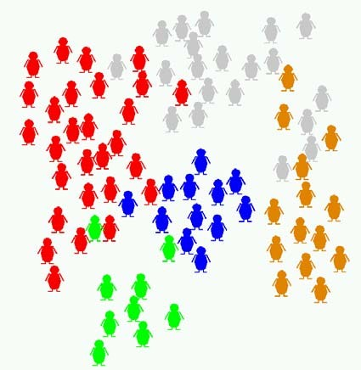
AI
Andrew W. Moore Carnegie Mellon University
awm@cs.cmu.edu (Questions welcome about anything)
An AI cocktail party
2

Slide 2
An AI cocktail party
How does intelligence work?
3
An AI cocktail party
How can we put professional decision- makers out of work?
How does intelligence work?
4

Slide 3
An AI cocktail party
How can we put professional decision- makers out of work?
These people have produced some fun questions to play with!
How does intelligence work?
5
An AI cocktail party
How can we put professional decision- makers out of work?
How can we actually apply this profitably?
These people have produced some fun questions to play with!
How does intelligence work?
6

Slide 4
An AI cocktail party
How can we put professional decision- makers out of work?
How can we actually apply this profitably?
Revolution. 5 years from now. A new age dawns. Paradigm shift. The one thing they missed up to now is...
These people have produced some fun questions to play with!
How does intelligence work?
7
Why do AI research?
Old fashioned answer:
Make programs that behave like the brain behaves
8

Slide 5
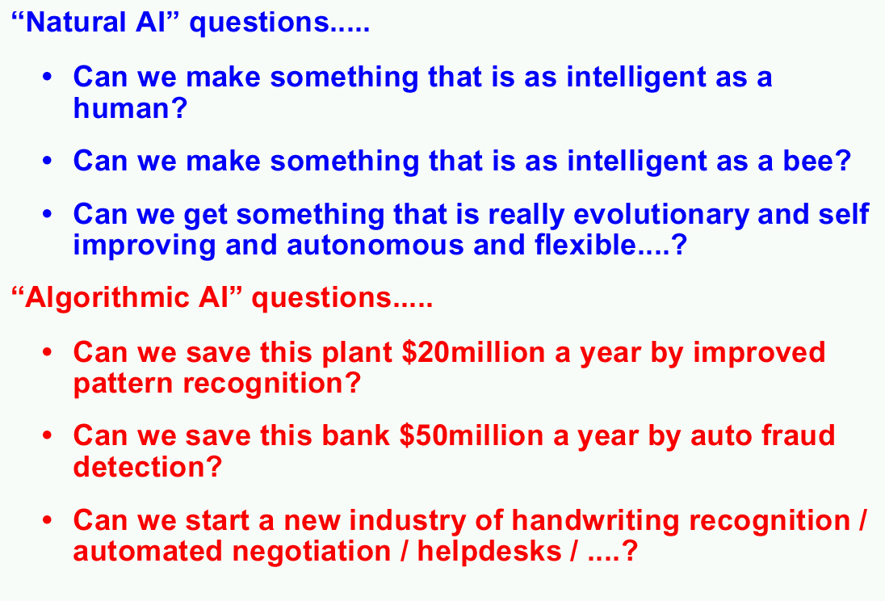
Why do AI research?
New fashioned answer:
Make programs that behave like the brain should behave
9
10

Slide 6
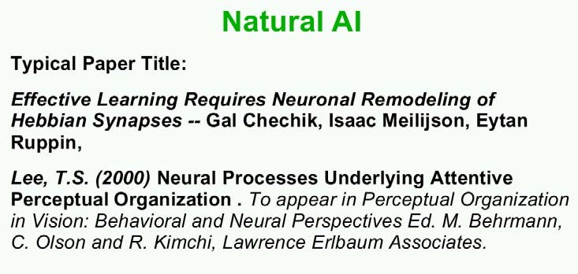
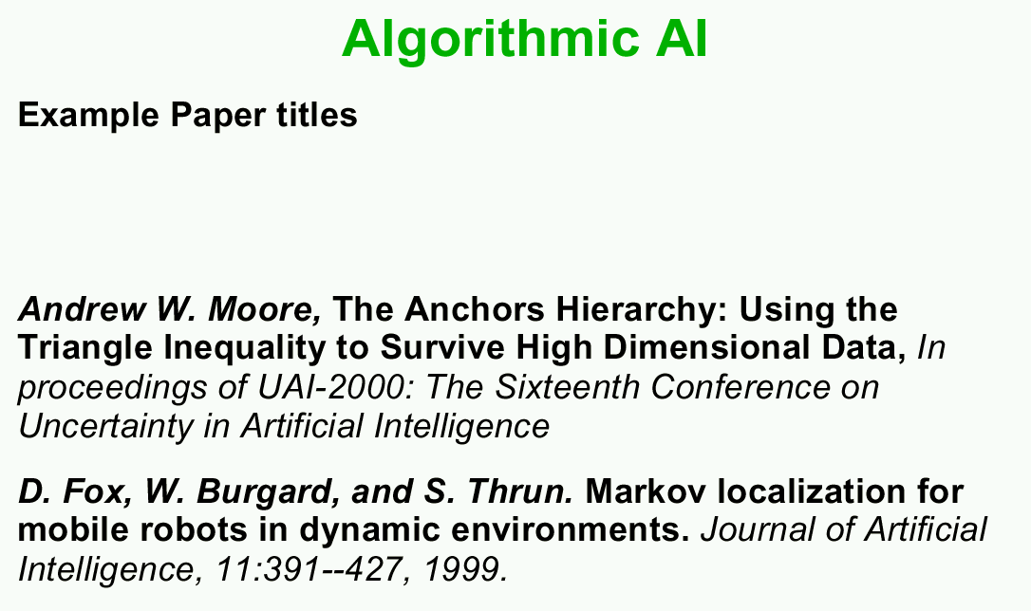
11
12

Slide 7
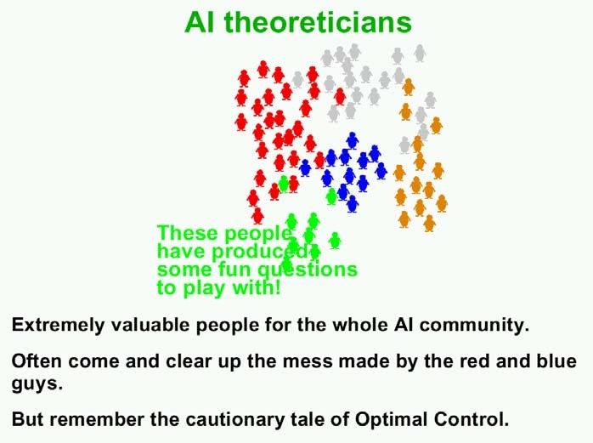
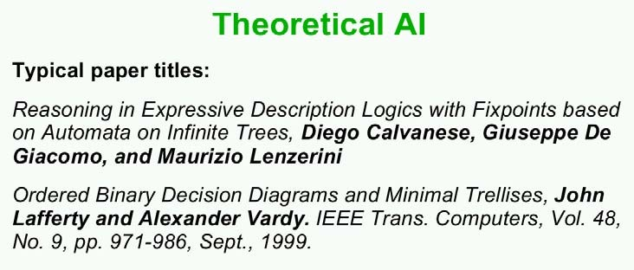
13
14

Slide 8
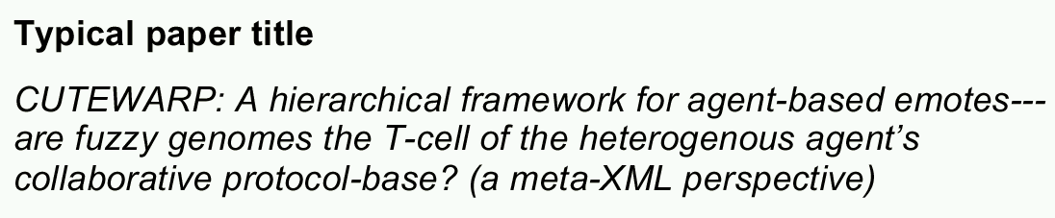
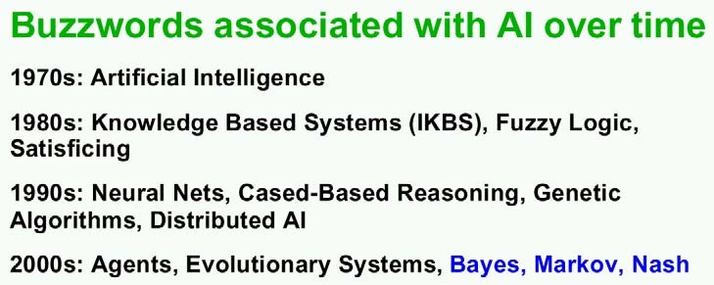
Snake-Oil A.I.
15
16

Slide 9
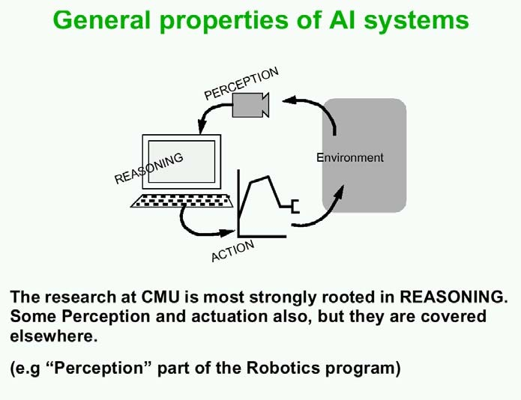
17
18

Slide 10
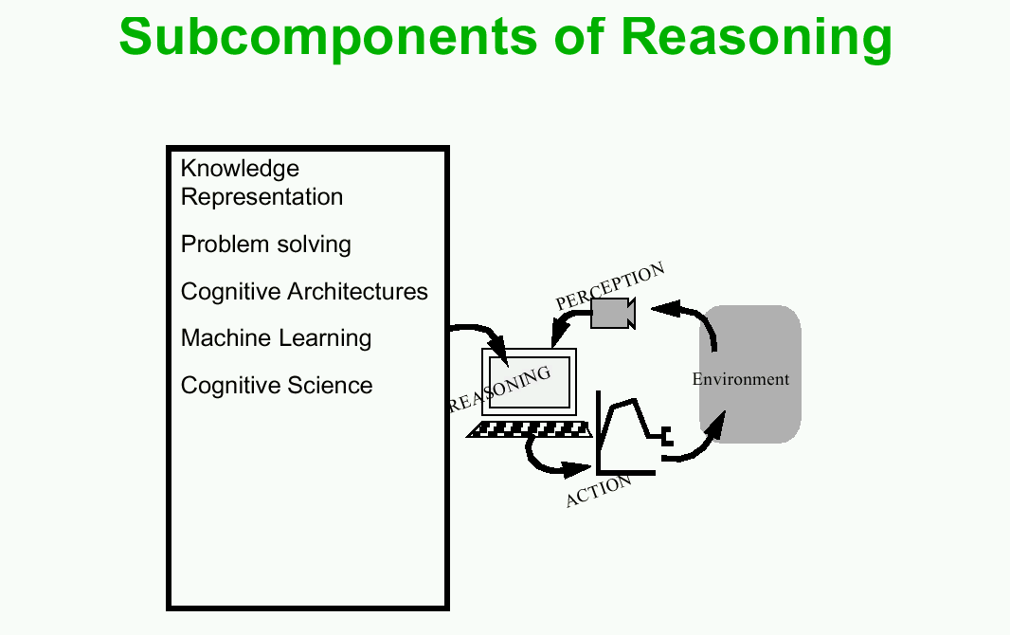
19

